Slide 1
Using Shared Decision-Making to Promote Patient-Centered Care
Alvin Moss, MD, FACP, FAAHPM

Slide 2
Objectives
Analyze a case in which shared decision-making is needed
Identify shared decision-making as a process to achieve informed consent and patient-centered care
Explain the 9 elements of shared decision making (SDM) to be able to evaluate quality of shared decision-making
Present a communication approach to shared decision-making
Consider how the failure of shared decision-making can contribute to conflict about goals of treatment and ethical dilemmas

Slide 3
Mrs. Z’s Uncertain Prognosis
71 yo woman admitted to ICU in septic shock requiring 2 vasopressors
Found to have spontaneous bacterial peritonitis complicating NASH cirrhosis
End-stage liver disease with varices, portal hypertension, and massive ascites
Develops oliguric AKI superimposed on CKD-no urine output-requires dialysis
Tolerates dialysis poorly because of low blood pressure
Nephrologist says she is “not a long-term outpatient dialysis candidate”

Slide 4
What more do you want to know?
ICU team believes CPR should not be offered to Mrs. Z because of the low likelihood of benefit
Also, ICU team considers present treatment “futile” because Mrs. Z is not likely not to survive to hospital discharge
Mrs. Z and son do NOT agree to any treatment limitations.
ICU team is frustrated with Mrs. Z and the son.
ICU team calls an ethics consultation. “Please help with communication. The patient is dying, and the patient and family do not get it.”

Slide 5
In clinical practice and training, prognosis—the probability of an individual developing a particular outcome over a specific period of time— typically receives less attention than diagnosing and treating disease. Yet many clinical decisions are not fully informed unless the patient’s prognosis is considered. Because of competing chronic conditions and diminished life expectancy, careful consideration of prognosis is particularly important for clinical decision making in older patients
Gill TM. JAMA 2012 Jan 11;307(2):199-200.

Slide 6
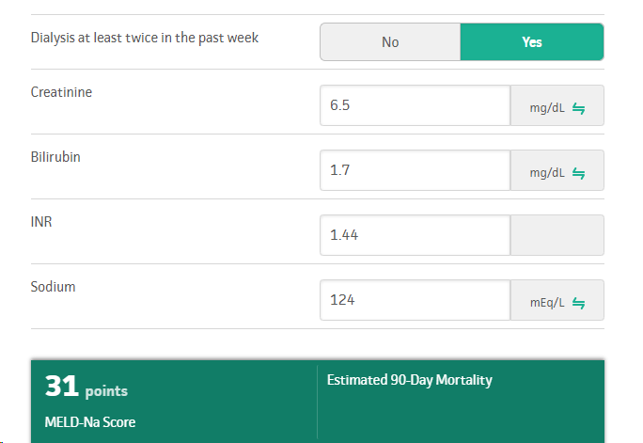
MELD-NA score for end-stage liver disease
MELD-NA predicted 3-month
survival 45%

Slide 7
Mrs. Z’s perspective and values
Very pleasant woman who has been through much with her liver disease
UGI bleed a year ago for which she had a variceal bleed clipped
Gets weekly paracenteses for 5-10 L of ascites removal
Gets encephalopathic if she skips lactulose
Widow; has a great relationship with her son with whom she lives
“I want to live to be 101 years old!”
Wants CPR, dialysis, and whatever else is needed to live
Wants to know what can be done for her blood pressure so that she can receive dialysis in the dialysis center in the town where she lives

Slide 8
Her reaction to being told that CPR will be painful and is unlikely to work!
“Well then, you young doctors will get some practice!”
“At least, I want you to try.”
“I am not ready to die.”

Slide 9
Patient-centered: providing care that is respectful of and responsive to individual patient preferences, needs, and values, and ensuring that patient values guide all clinical decisions.

Slide 10
Shared Decision-Making Relationship
a process of communication between patient and physician based on patient’s overall condition (prognosis)
reach agreement on a specific course of treatment
after patient describes values and preferences
physician presents Dx, Px, and treatment alternatives with their attendant benefits and risks
each participant better understands the relevant factors
and shares responsibility in the decision
Barry MJ et al. Shared decision making:
The pinnacle of patient-centered care. New Engl J Med 366:780-781, 2012

Slide 11
Clear Communication Practices to Improve Shared Decision-Making
Use of medical jargon-free language
Presentation of new information slowly and in small chunks
Use of pictures and drawings to promote understanding
Routine questions to patients to elicit their clarifying questions
Use of the teach-back method to confirm patients’ understanding

Slide 12
Respect talk
“…shared decision making is a process in which decisions are made in a collaborative way, where trustworthy information is provided in accessible formats about a set of options, typically in situations where the concerns, personal circumstances, and contexts of patients and their families play a major role in decisions.”
Elwyn G. BMJ 2017

Slide 13
Use of ASK-TELL-ASK to Implement Shared Decision-Making
ASK
TELL
ASK
What is your understanding of your medical condition now?
How serious is it?
What is most important to you in receiving treatment?
What do you wish to avoid?
What concerns do you have?
Who would you trust to speak for you if you became too sick to speak for yourself?
Likely future complications
Prognosis
Information about possible future interventions such as dialysis, ventilator and CPR
Explore again to elicit concerns, understanding of effectiveness of treatments, values for what is important in future circumstances
What questions do you have?
To be sure I communicated clearly, please tell me in your own words what we discussed
What will you tell your about what we discussed?
Download 1-Pager
Download Cards
http://go.gwu.edu/asktellask

Slide 14
Operationalization of Shared Decision-Making*
Patient aware of choice and decision to be made
Opportunity to express needs, values, and preferences
Informed of prognosis and all options
Benefits and risks of each
Patient decision aid to standardize information/facilitate understanding
Adequate time for decision (not rushed)
Active participant
Co-equal in decision with physician
Co-equal in developing plan of care with physician
*Kriston L, et al. The 9-item Shared Decision-Making Questionnaire (SDM-Q-9). Patient Educ Couns. 2010;80(1):94-99.

Slide 15
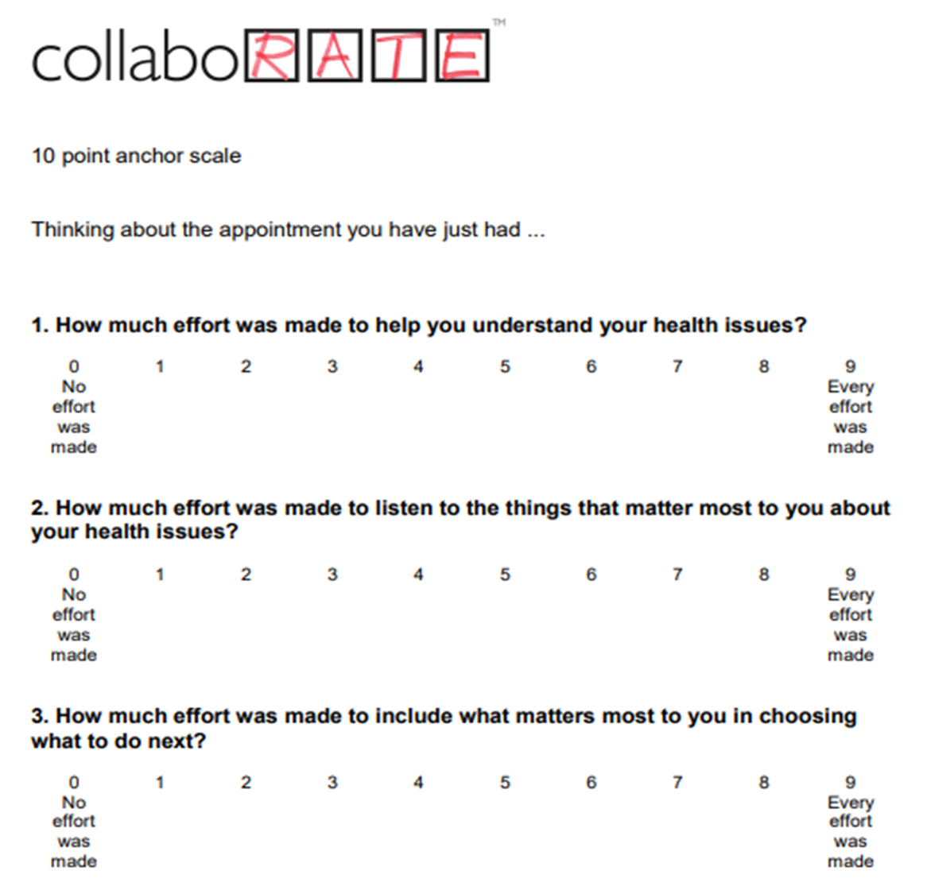
Download

Slide 16
Bad Example #1: Tell-tell-tell

Slide 17
Seek to Understand, then to be Understood
·Help patients feel safe by giving them a sense of control
Demonstrate you are listening by offering reflections | “I heard you say that you even though you have been very sick you appreciate every moment of life that you have; can you tell me more about that?”
Ask permission before giving information | “I’m hearing that it’s really important to you to be able to go home. Would it be okay with you if I shared some concerns that the doctors have about that?”
Elicit patient’s values | “When you think about your future healthcare, what feels most important to you?”
Use empathy | “It’s painful to think about ‘what-if’ scenarios, and you want to be positive.” “Do I have that right?” “What do you want to be told about likely future issues in your care?”

Slide 18
Cultural Competency vs. Cultural Humility
Cultural Competency
Cultural Humility
Suggests there is an end-point; one can know all there is to know.
Doesn’t appreciate culture within culture
Acknowledges no one can ever know all there is to know.
Set of attitudes and approaches
Self-reflection; self-critique
Recognizes power imbalances
Prasad SJ, Nair P, Gadhvi K, Barai I, Danish HS, Philip AB. Cultural humility: treating the patient, not the illness. Med Educ Online. 2016 Feb 3;21:30908. doi: 10.3402/meo.v21.30908. PMID: 26847853; PMCID: PMC4742464

Slide 19
What would you recommend for resolving the conflict with Mrs. Z?

Slide 20
The rest of the story…
A day later with continuing antibiotics, the septic shock resolved.
Nephrology said Mrs. Z would need to tolerate conventional hemodialysis to be discharged to an outpatient dialysis center
She was given midodrine before dialysis treatments and managed to get through them.
She was discharged to a rehab facility with planned discharge home later.

Slide 21
What did we learn?
Patients with decision-making capacity have the right to make decisions that seem unwise to the treating healthcare team.
Time-limited trials, as occurred in the case of Mrs. Z, help to reduce uncertainty.
Shared decision-making is the best way to involve patients in decisions with treatment uncertainty or there is conflict over treatment goals.

