Slide 1
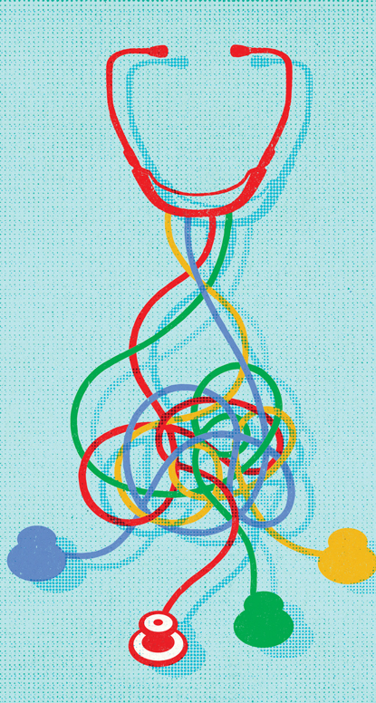
Ethics Consults on What Basis: Is Principlism All You Need?
Defending Principlism
Daniel Miller

Slide 2
Smith’s Objections
Since Principlism assigns equal weight to each of the four principles, it has no way to adjudicate conflicts among the principles in particular cases.
To adjudicate conflicts among the principles, the Principlist needs to adjust the weights.
But since Principlism assigns equal weight to each of the principles, to adjust the weights is to change the theory.
The principles are useful tools but must be supplemented by other tools to offer guidance about cases.

Slide 3
Reply #1
Principlism is committed to the view that no principle has a universal priority over any of the others.
But this doesn’t mean that an ethical consideration can’t have a greater weight than a competing consideration in a particular case.
The abstract principles themselves don’t have any weight. Instead, it’s actual considerations in particular cases that have weights.
E.g., Right to refuse surgery vs. prolonged life

Slide 4
Reply #2
The principlist doesn’t change the theory by assigning different weights to different considerations.
E.g., risk of minor impairment vs. risk of death
The principlist instead recognizes that considerations just have different weights in different cases.
Principlism does not maintain that all considerations falling under a certain principle have the same weight across all cases; it instead maintains the opposite.
That’s why we can’t say that any one principle has universal priority over the others.

Slide 5
Reply #3
The principles are not enough. But doesn’t mean that Principlism isn’t enough.
Principlism also involves specifying the principles to particular cases and weighing conflicts.
This adds more content to the principles as they apply to certain kinds of cases, and enriches the theory.
The principlist is free to incorporate the insights of other ethical approaches on board and utilize them as so long as those insights can reconciled with the four principles.

